Slide 1
Mission: Azure Kubernetes Service
Carlos Mendible - @cmendibl3
Sergio Navarro Pino - @snavarropino

Slide 2
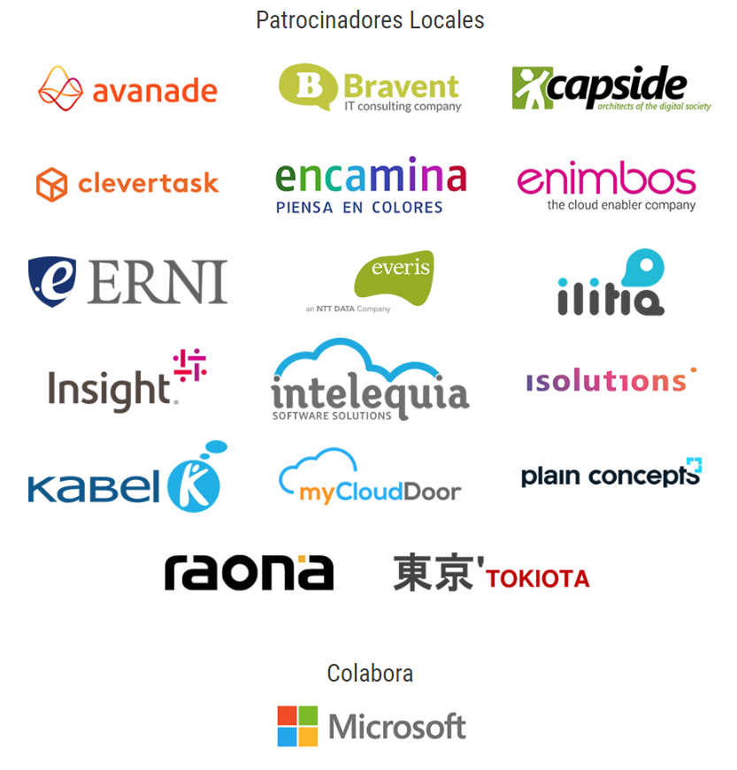
¡Gracias!

Slide 3
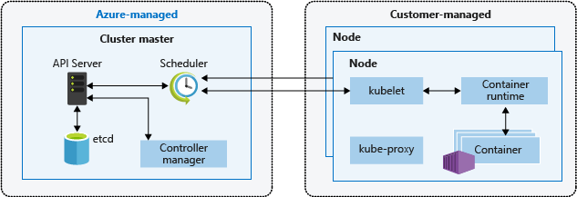
AKS: Architecture
Cluster master nodes provide the core Kubernetes services and orchestration of application workloads & are managed by Azure
You cannot access the master nodes directly
Custom Ubuntu flavor
4 minor versions of k8s
Notes:
Master
Access to the API server must be controlled using RBAC and Azure Active Directory.
Nodes
The Azure platform automatically applies OS security patches to the nodes on a nightly basis. However Azure won’t restart the VM’s, if required you have to do it
Nodes are deployed into a private virtual network subnet, with no public IP addresses assigned.
The data stored in the nodes managed disks is automatically encrypted at rest within the Azure platform.

Slide 4
AKS: Limits & Resource Reservations
Max clusters per subscription: 100
Max nodes per cluster: 100
Max pods per node: Basic Networking: 110
Max pods per node: Advanced Networking : 110
CPU 60 ms
Memory 20% up to 4 GiB
Notes:
Aquí están los límites: https://docs.microsoft.com/fi-fi/azure/aks/container-service-quotas
Ojo q en advanced x defecto es 30, pero puedes cambiarlo al momento de la creación (no desde le portal)
La reserva de recursos es para el funcionamiento de kubernetes. Hablamos de los nodos
Si tienes 8 GB reservara 1,6GB
Si tienes 32 seria 6,4, así que lo deja en 4

Slide 5
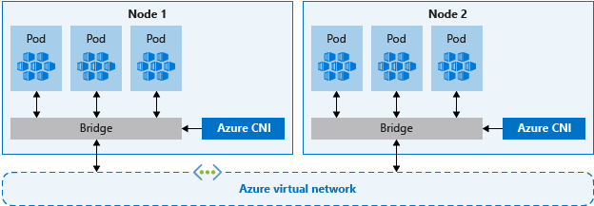
AKS: Networking
Basic networking
The Azure platform manages the network configuration of the cluster and pods.
With basic networking, you can't define network configuration such as subnet names or the IP address ranges assigned to the AKS cluster.
Nodes in an AKS cluster configured for basic networking use the kubenet Kubernetes plugin.
Expose a Kubernetes service externally or internally through the Azure Load Balancer.
Pods can access resources on the public Internet.
Advanced networking
Advanced networking places your pods in an Azure virtual network that you configure.
Better performance than basic networking
Notes:
https://docs.microsoft.com/en-us/azure/aks/operator-best-practices-network
Nodes in an AKS cluster configured for advanced networking use the Azure Container Networking Interface (CNI) Kubernetes plugin.
Hablaremos más adelante pero si eliges “Advanced networking“puedes tb añadir el plugin calico, que nos permitirá establecer políticas

Slide 6
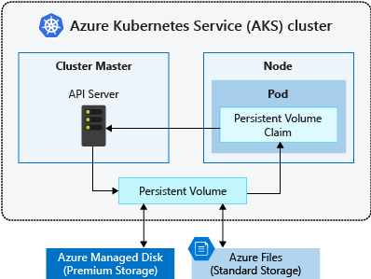
AKS: Storage
Azure Disks:
Use Premium storage.
Mounted as ReadWriteOnce, so are only available to a single node
Azure Files:
Only use Azure Standard storage backed by regular HDDs
Used to mount a SMB 3.0 share backed by an Azure Storage account to pods. Files let you share data across multiple nodes and pods.
Notes:
https://docs.microsoft.com/en-us/azure/aks/operator-best-practices-storage
Los discos nos van a dar mas performance, pero necesitaríamos q el pod pudiese recrear info si cambia de nodo

Slide 7
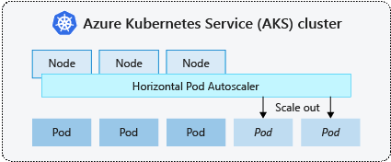
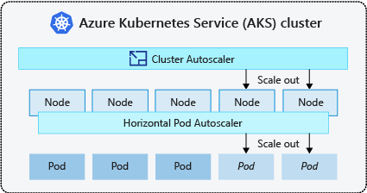
AKS: Scale
Horizontal pod autoscaler
AKS uses the horizontal pod autoscaler (HPA) to monitor the resource demand and automatically scale the number of replicas.
Needs Requests & Limits specified for the containers.
Cluster autoscaler
Works on RBAC-enabled clusters
Notes:
No hemos probado el cluster auto-scaler, así que no podemos decir mucho mas. Peeero si que veremos el horizontal pod scaler

Slide 8
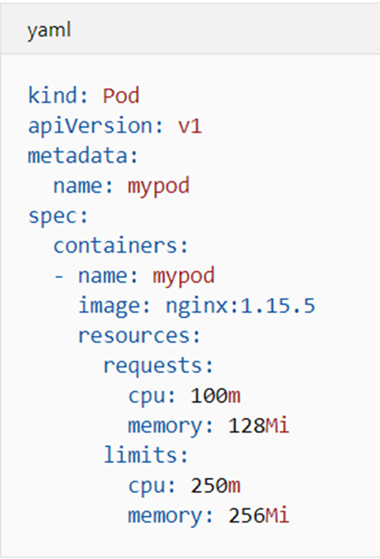
AKS: Pod requests and limits
Pod requests
amount of CPU and memory that the pod needs.
Pod limits
Maximum amount of CPU and memory that a pod can use.
Notes:
Pod requests define a set amount of CPU and memory that the pod needs. These requests should be the amount of compute resources the pod needs to provide an acceptable level of performance.
Pod limits are the maximum amount of CPU and memory that a pod can use. These limits help prevent one or two runaway pods from taking too much CPU and memory from the node. This scenario would reduce the performance of the node and other pods that run on it.

Slide 9

Demo
Horizontal Pod Autoscaling

Slide 10
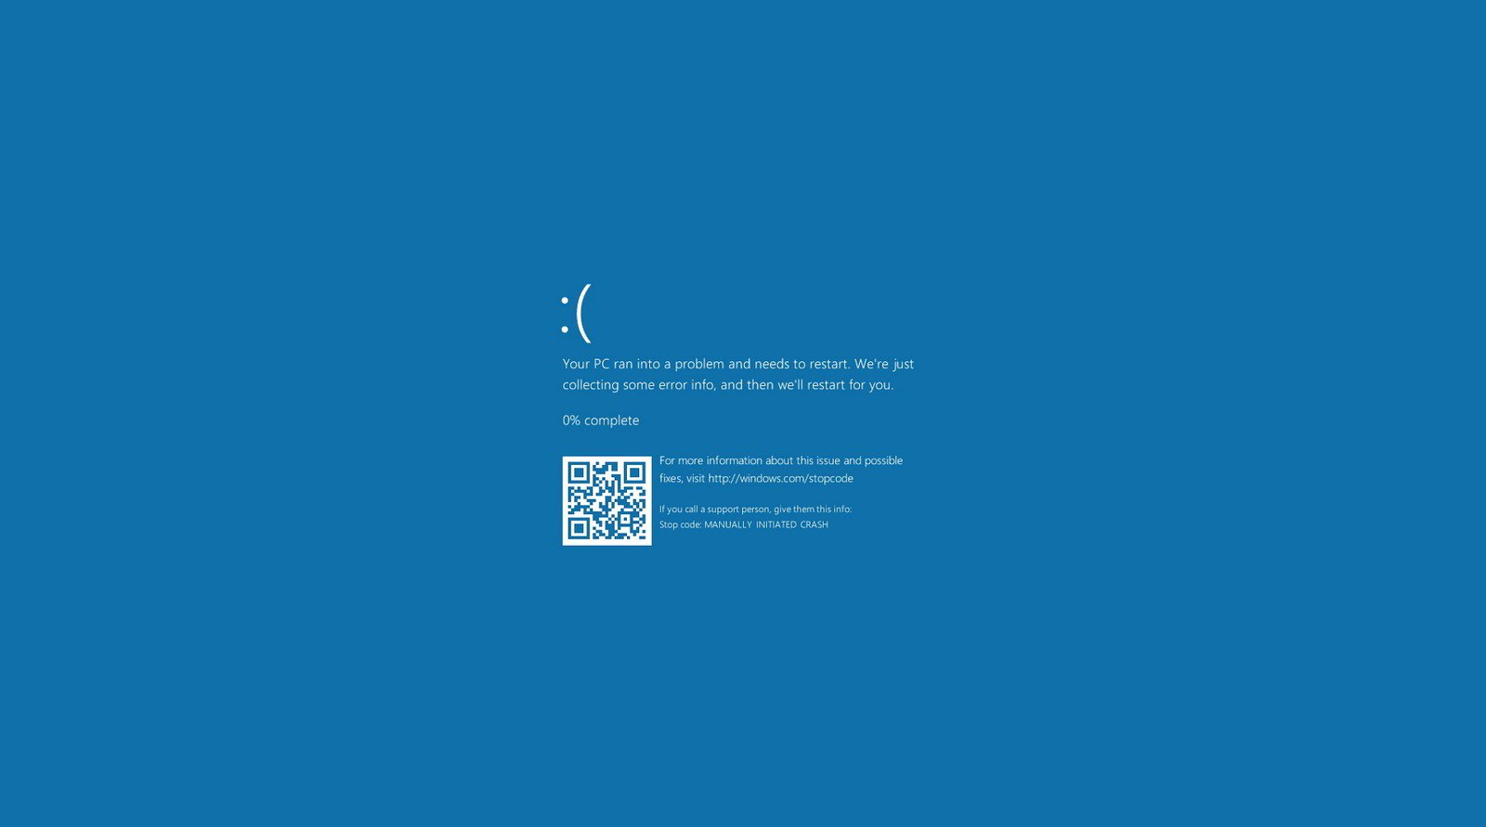

Slide 11
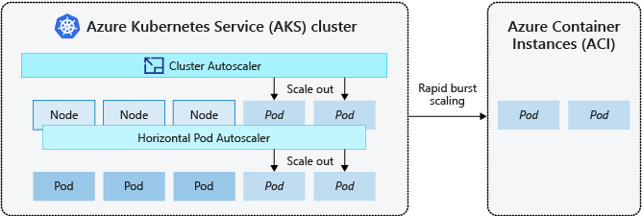
AKS: Burst out with ACI
Extend the cluster installing the Virtual Kubelet.
ACI lets you quickly deploy container instances without additional infrastructure overhead.
Notes:
Dos casos de uso:
Escalar rápidamente.
Antes hablábamos que se podía escalar, incluso automáticamente añadiendo nodos al cluster. Pero eso lleva tiempo. Con ACI se trata de levantar un contenedor
- Otro tema interesante es que podríamos ejecutar contenedores Windows allí, aunque nuestro cluster es 100% linux

Slide 12

Demo
virtual-kubelet & ACI

Slide 13
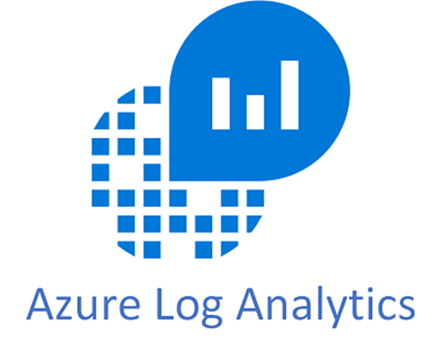
AKS: Monitoring and Logging
Requires Log Analytics Workspace.
Deploys a DaemonSet inside the cluster.
Grafana Integration
Notes:
CARLOS ESTA PARA TÍ!

Slide 14

Demo
Monitoring and Grafana Integration

Slide 15
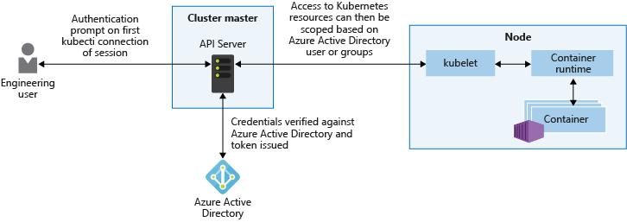
AKS: AAD Integration
Provides granular filtering of the actions that users can perform, using role-based access controls (RBAC).
Assign AAD groups to roles.
Notes:
Azure Kubernetes Service (AKS) can be configured to use Azure Active Directory (AD) for user authentication. In this configuration, you can sign in to an AKS cluster using your Azure Active Directory authentication token. Additionally, cluster administrators are able to configure Kubernetes role-based access control (RBAC) based on a user's identity or directory group membership.

Slide 16
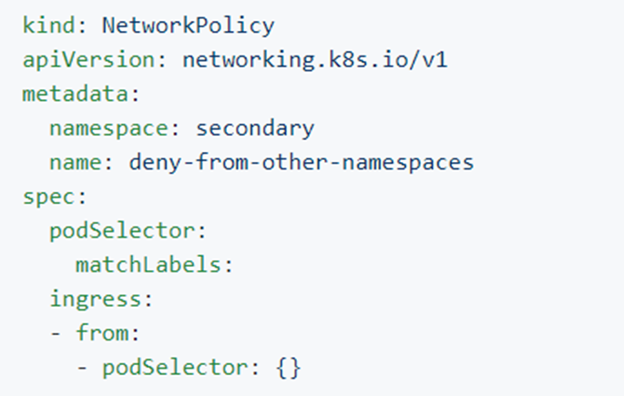
AKS: Network Policies (Preview)
All pods in an AKS cluster can send and receive traffic without limitations, by default
Secure traffic between pods using network policies
Choose to allow or deny traffic based on settings like assigned labels, namespace, or traffic port
Notes:
Calico: https://github.com/projectcalico/calico
https://github.com/ahmetb/kubernetes-network-policy-recipes/blob/master/04-deny-traffic-from-other-namespaces.md

Slide 17
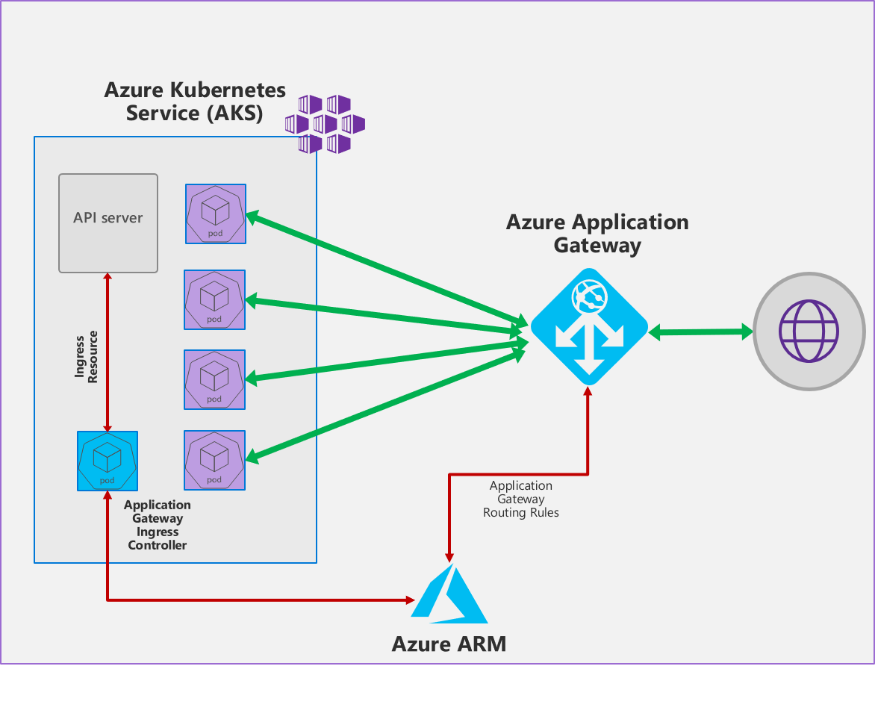
AKS: Ingress Controllers
AKS HTTP application routing feature: Azure platform creates the Ingress controller and an External-DNS
Use NGINX + Let's Encrypt
SSL/TLS termination
Azure Application Gateway Ingress Controller
WAF (Web application firewall)
Pod Managed Identity
Notes:
An ingress controller is a piece of software that provides reverse proxy, configurable traffic routing, and TLS termination for Kubernetes services. Kubernetes ingress resources are used to configure the ingress rules and routes for individual Kubernetes services. Using an ingress controller and ingress rules, a single IP address can be used to route traffic to multiple services in a Kubernetes cluster.
3 opciones en AKS
HTTP app routing feature: opcion muy sencilla no pensada para producción. https://docs.microsoft.com/es-es/azure/aks/http-application-routing
NGINX + letys encypt, es una opción “más manual”
Azure Application Gateway es una opción que podrías decir es más Azure y menos Kubernetes

Slide 18

AKS: Secrets
Use Azure Key Vault for secrets when needed:
Kubernetes-KeyVault-FlexVolume.
Pod Managed Identity (Preview)
Notes:
With the Key Vault FlexVolume, developers can mount multiple secrets, keys, and certs stored in Key Management Systems into their pods as a volume. Once the Volume is attached, the data in it is mounted into the container's file system.

Slide 19
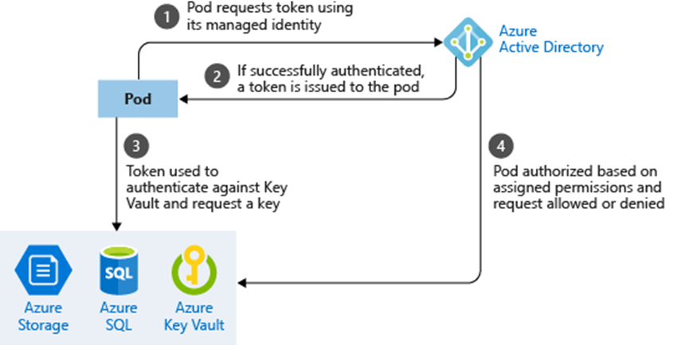
AKS: Use pod managed identities
The pod is assigned an Azure Identity that lets them authenticate to Azure Active Directory and receive a digital token.
The digital token can be presented to other Azure services that check if the pod is authorized to access the service and perform the required actions.
Notes:
Aad Pod Identity enables applications running in pods on Kubernetes clusters deployed on Azure(managed or unmanaged) to securely access cloud resources by leveraging Azure Active Directory(AAD). Administrators can configure identities and bindings, to match pods with identities. Following this, without any code modifications, the applications running within the pod can access any cloud resources that depend on AAD as Identity Provider. The administrator interactions with the aad-pod-identity are via Kubernetes primitives.

Slide 20

Demo
KeyVault: Pod Managed Identity

Slide 21
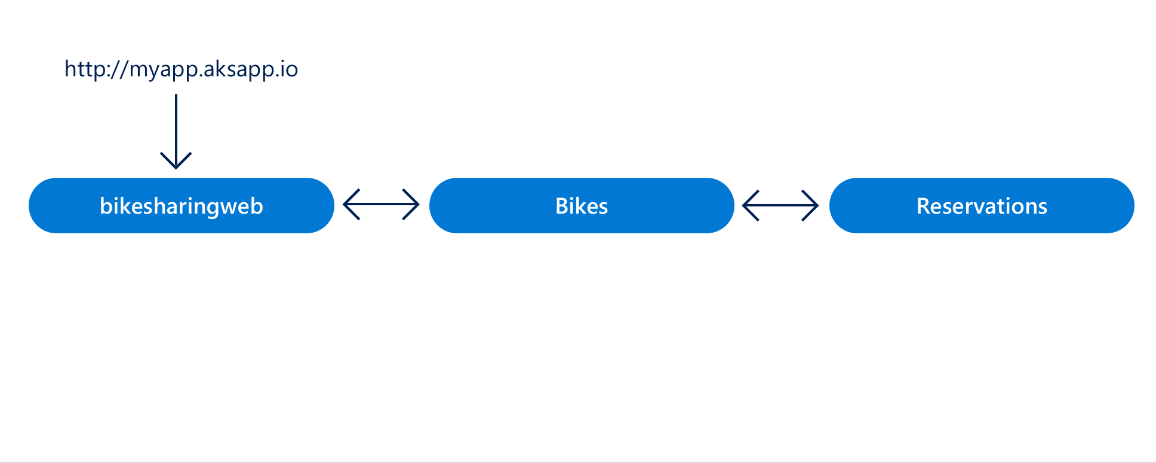
AKS: AZDS (Preview)
A rapid, iterative Kubernetes development experience for teams
Work directly in AKS
Iterate and debug using Visual Studio or Visual Studio Code.
Generate Docker and Kubernetes configuration-as-code assets.
Share a cluster with your team and collaboratively work together.
Develop your code in isolation, and do end-to-end testing with other components without replicating or mocking up dependencies.
Notes:
CARLOS ESTA PARA TÍ!
A rapid, iterative Kubernetes development experience for teams
Minimize local dev machine setup for each team member and work directly in AKS, a managed Kubernetes cluster in Azure.
Rapidly iterate and debug code directly in Kubernetes using Visual Studio 2017 or Visual Studio Code.
Generate Docker and Kubernetes configuration-as-code assets for you to use from development through to production.
Share a managed Kubernetes cluster with your team and collaboratively work together.
Develop your code in isolation, and do end-to-end testing with other components without replicating or mocking up dependencies.

Slide 22

Demo
Azure Dev Spaces

Slide 23

Call to Action

Slide 24
¡Gracias!

